Slide 1

School of E&TC Engineering
TY-BTech Major Project (SEM-VI)
Blind Person Reader and Language Translator System
SDG (Sustainable Development Goals) 10:Reduced Inequalities
Group Members
Name PRN
Durgesh Dahifale 202402060010
Guide:
Dr. Vrushali Waghmare

Slide 2
Title
Introduction
Literature Survey
Summary of Literature Survey
Problem Statement
Objectives of the Project
Block diagram
Methodology
Component selection
Sustainable Development Goals (SDGs)
Implementation Plan / Work Plan
Phase-1 Result
Phase-2 Result
3D Model Prototype
3D Model
Conclusion
References
Content

Slide 3
Title
Blind Person Reader and Language Translator System

Slide 4
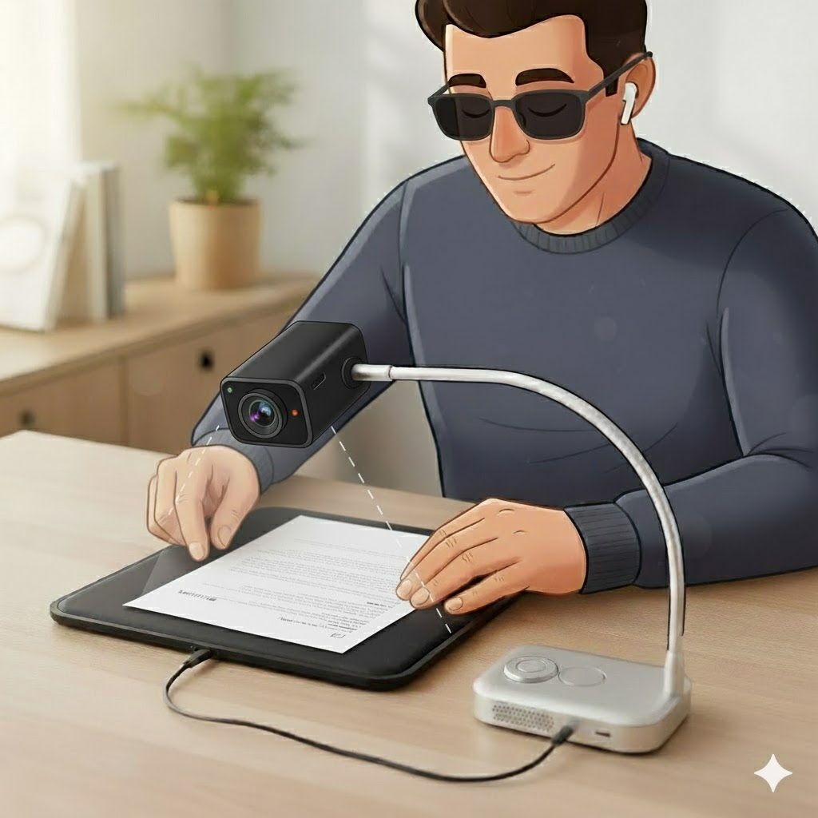
Introduction
This project develops an assistive system for visually impaired individuals to overcome challenges in reading and multilingual communication. The system captures printed text and converts it into speech through text-to-speech (TTS), giving users immediate access to written material. It further integrates for conversational interaction and real-time translation, enabling multilingual support. Using affordable hardware and open-source software frameworks, the solution is cost-effective, user-friendly, and enhances accessibility, independence, and social participation for blind users.

Slide 5
Literature Survey
Sr No. | Name of paper | Author(s) & Year | Board | Libraries | Hardware | Software | Work | Decision
1 | Image Text to Speech Conversion in the Desired Language (Raspberry Pi) [1] | Authors: Rithika H., B. Nithya Santhoshi Year: 2016 — ICCICR 2016, IEEE | Raspberry Pi | Tesseract OCR, Google Speech API, Translator, eSpeak | Camera, SD card, speaker | Python | Image → OCR → Translate → TTS | Multilingual (53 languages); useful for travelers & blind users.

Slide 6
Literature Survey
Sr No. | Name of paper | Author(s) & Year | Board | Libraries | Hardware | Software | Work | Decision
2 | Raspberry Pi Based Intelligent Reader for Visually Impaired Persons [2] | Authors: Prof. Vaibhav V. Mainkar et al. Year: 2020 — ICIMIA 2020, IEEE | Raspberry Pi | ImageMagick, Tesseract, eSpeak | Pi camera, headset | Raspbian, Python | Image → Process → OCR → TTS | Accurate reading; works for both colored & grayscale text.

Slide 7
Literature Survey
Sr No. | Name of paper | Author(s) & Year | Board | Libraries | Hardware | Software | Work | Decision
3 | Reading and Translator with Raspberry Pi for Blind People [3] | Authors: Vagdevi Adusumilli et al. Year: 2023 — ICACCS 2023, IEEE | Raspberry Pi | Tesseract OCR, eSpeak | Camera, earphones | Python | Image → OCR → Translate → Speech | English–Telugu reader; simple, self-operable.

Slide 8
Literature Survey
Sr No. | Name of paper | Author(s) & Year | Board | Libraries | Hardware | Software | Work | Decision
4 | Regional Language Reading Aid for Blind People using Raspberry Pi [4] | Authors: N. Sathish Kumar, V. Nithish, P. Roshan Acharya, V. Raswanth Year: 2024 — SCOPES 2024, IEEE | Raspberry Pi B+ | OCR, Text-to-Voice | Pi camera, earphones | Python | Image → OCR → TTV | 93% accuracy; multi-language; low-cost solution.

Slide 9
Literature Survey
Sr No. | Name of paper | Author(s) & Year | Board | Libraries | Hardware | Software | Work | Decision
5 | Vision Voice: Raspberry Pi-Based Text-to-Audio Converter [5] | Prof. Kaushalya Thopate, Shaunak Karvir, Kavya Amrutkar, Omkar Kumbhar, Tarun KasliwalYear: 2024 — INNOCOMP 2024, IEEE | Raspberry Pi 3 | Tesseract, TTS engine | Camera, speaker | Python | OCR → TTS → Audio | Efficient OCR-TTS integration; ideal for blind users.

Slide 10
Literature Survey
Sr No. | Name of paper | Author(s) & Year | Board | Libraries | Hardware | Software | Work | Decision
6 | Stable-TTS: Stable Speaker-Adaptive Text-to-Speech Synthesis via Prosody Prompting [6] | Authors: Wooseok Han, Minki Kang, Changhun Kim, Eunho YangYear: 2025 — ICASSP 2025, IEEE | GPU / Cloud / adaptable to Pi | Diffusion Model, PLM, Prior-preservation Loss, HiFi-GAN | Hardware: GPU system | PyTorch, Python | Text → Diffusion-based adaptive TTS | Advanced speaker-adaptive system; high-quality voice synthesis.

Slide 11
Literature Survey
Sr No. | Name of paper | Author(s) & Year | Board | Libraries | Hardware | Software | Work | Decision
7 | Web Accessibility Framework for the Arab Disabled (Extended) [7] | Authors: —Year: 2012 | Web server | ArSL, Arabic Moon, Braille converters | PC / Mobile | Web modules | Scan → Convert → ArSL/Braille/Speech | Accessible communication system for Arabic blind users.

Slide 12
Literature Survey
Sr No. | Name of paper | Author(s) & Year | Board | Libraries | Hardware | Software | Work | Decision
8 | An Interactive Intelligent Web-based Text-to-Speech System [8] | Authors: — (AAJRSR Journal)Year: 2021 — Asia-Africa Journal of Recent | Web-based | NLP + DSP models, JS speech synthesis | Any computer/mobile | Web (HTML/JS/CSS) | Text input → NLP → TTS → Audio | Web TTS solution; suitable for e-learning, online reading.

Slide 13
Literature Survey
Sr No. | Name of paper | Author(s) & Year | Board | Libraries | Hardware | Software | Work | Decision
9 | Web Accessibility Framework for Tamil Deaf-Blind [9] | Authors: —Year: 2012 — IJCA Proceedings, EGov’12 | Web server (3-tier architecture) | Tamil Sign Language (TSL), Moon/Braille support | Computer with internet access | Web application | Page scan → Convert → Output as TSL/Moon/Braille/Speech | Early accessible web design for Tamil disabled users.

Slide 14
Literature Survey
Sr No. | Name of paper | Author(s) & Year | Board | Libraries | Hardware | Software | Work | Decision
10 | JARVIS: A PC Voice Assistant [10] | Authors: Jash Vora, Deepak Yadav, Ronak Jain, Dr. D. GuptaYear: 2021 — IJASRW, Vol.4, Issue 7 | PC/Laptop | SpeechRecognition, pyttsx3, Wikipedia, WolframAlpha | Microphone, speaker | Python | Voice → Command → Execution → Speech output | Hands-free voice assistant; supports visually impaired users.

Slide 15
Summary of Literature Survey
1. Most projects focus on helping visually impaired people using OCR and Text-to-Speech (TTS).
2. Raspberry Pi is the most commonly used low-cost board.
3. Many systems support multiple languages like English, Tamil, Telugu, and Malayalam.
4. Image preprocessing and AI models improved reading accuracy and speed.
5. New systems use object detection, translation, and scene text for smarter reading.
6. Overall, technology has moved from simple OCR tools to intelligent, multilingual reading assistants.

Slide 16
Problem Statement
To design a blind person reader system that captures printed text from an A4 page, translates it into the desired language, and audibly delivers the output using a Raspberry Pi, camera, and speaker. The system aims to assist visually impaired individuals by enabling them to access and understand printed information in multiple languages, thereby promoting greater independence and inclusivity.

Slide 17
1. To implement an end-to-end system for blind users that captures printed text from books or documents using a camera, processes it with OCR (Optical Character Recognition). 2. To enable real-time translation of detected text from a foreign language into the user's preferred language before audio output. 3. To provide offline Text-to-Speech (TTS) functionality so that blind users can listen to content without needing internet access. 4. To design the system in a low-cost and portable manner, so that it can be used easily by blind students and common people. 5. To ensure multilingual support (e.g., Marathi, Hindi, English, French, etc.) for better accessibility. 6. To enhance usability and independence of visually impaired persons by reducing their dependency on others for reading and understanding printed text.
Objectives

Slide 18
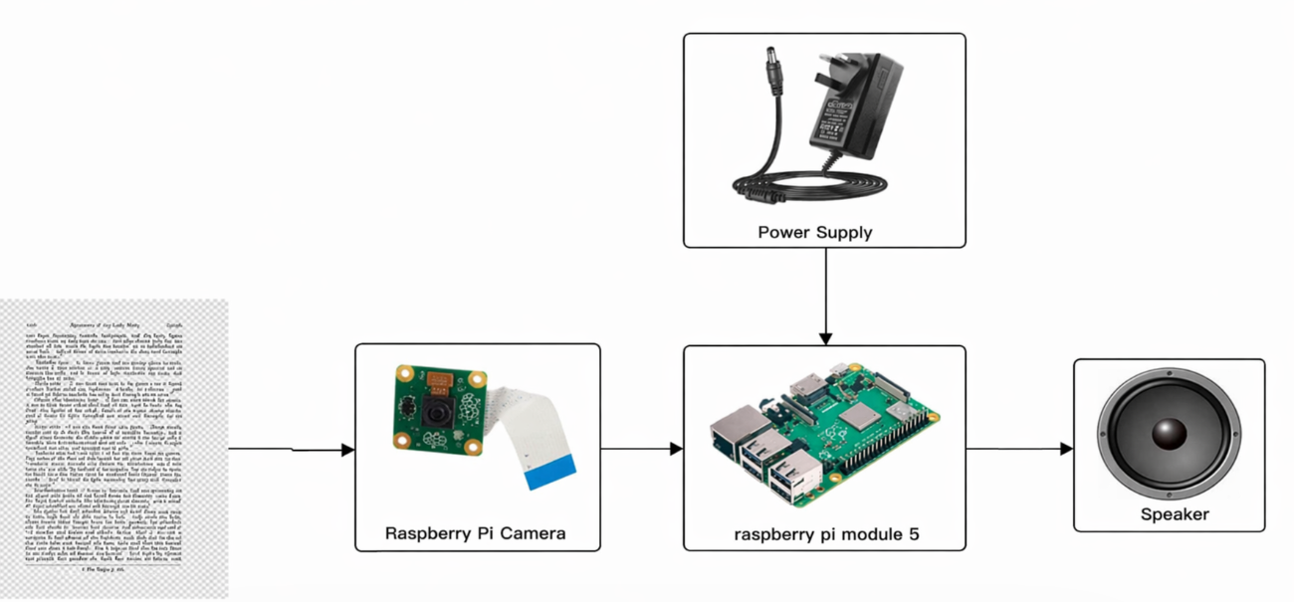
Block Diagram

Slide 19
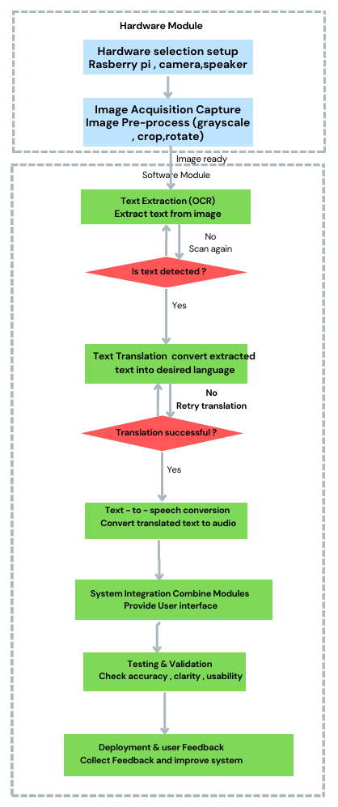
Methodology

Slide 20
Component Selection - Board
Sr No. | Feature | Arduino Uno | Raspberry Pi 4 | Raspberry Pi 5
1. | Operating System | No OS | Linux-based OS (Raspberry Pi OS) | Linux-based OS (Raspberry Pi OS, faster boot)
2. | Storage | No internal storage | microSD card | microSD card (faster I/O support)
3. | Connectivity | USB, GPIO, limited serial | USB 3.0, HDMI, Ethernet, Wi-Fi, Bluetooth | Dual USB 3.0, PCIe, HDMI, Gigabit Ethernet, faster Wi-Fi & Bluetooth
4. | Camera Support | No Camera Port | 2 × CSI camera ports | 2 × CSI/DSI ports with higher data rate
5. | Best Use | Sensor control, small IoT | Medium AI, multimedia projects | High-performance AI, camera, TTS, translation

Slide 21
Software Comparison
Component Selection - Camera
Sr No. | Feature | Raspberry Pi Camera | Fingers Webcam
1. | Best For | OCR and text reading | Photo captured
2. | Connection | CSI port | USB port
3. | Speed | Fast capture | Slower
4. | Focus | Auto | Auto
5. | Resolution | HI-RE 1080 | Low compare to ras pi camera

Slide 22
Software Comparison
Software Selection
Category | Best Option | Reason
OCR Accuracy | Regional Language Reader | Uses better image preprocessing and supports handwriting
Offline Operation | Regional Language Reader | pyttsx3 does not require Internet
Speech Quality | Stable-TTS | Neural model gives human-like speech clarity
Lightweight Deployment | Vision Voice | Simpler and faster on low-power devices
Multilingual Potential | Regional Language Reader + Stable-TTS Hybrid | Combine multilingual OCR + advanced TTS

Slide 23
Software Comparison
Sustainable Development Goals (SDGs)
The project aligns with the following United Nations Sustainable Development Goals:
SDG 4– Quality Education :
The system helps blind and visually impaired people read books, study materials, and documents independently, improving access to education.
SDG 9– Industry, Innovation and Infrastructure :
The project uses modern technology such as OCR and Text-to-Speech, promoting innovation in assistive technologies.
SDG 10– Reduced Inequalities :
SDG 10 aims to reduce inequality within and between countries. It promotes equal opportunities, inclusion, and support for disadvantaged groups.

Slide 24
Project Plan
Semester 5th – Basic Setup
Study problem statement (Assistive system for blind users).
Literature Survey (existing OCR, Translation, TTS)
Identify project requirements (hardware + software)
Install tools: Python, OCR libraries, Hugging Face models, pyttsx3.
Basic testing of OCR + TTS modules on laptop
Semester 6th – Advanced Features
Build an OCR + translation module using EasyOCR/Tesseract and Helsinki-NLP models.
Add Offline Text-to-Speech (pyttsx3 / Coqui TTS).
Basic integration: Camera → OCR → TTS → Audio.
Test with single language (e.g., English → Marathi).
Test with multiple languages and complete the full system with 3D-printed device design and full project integration.

Slide 25
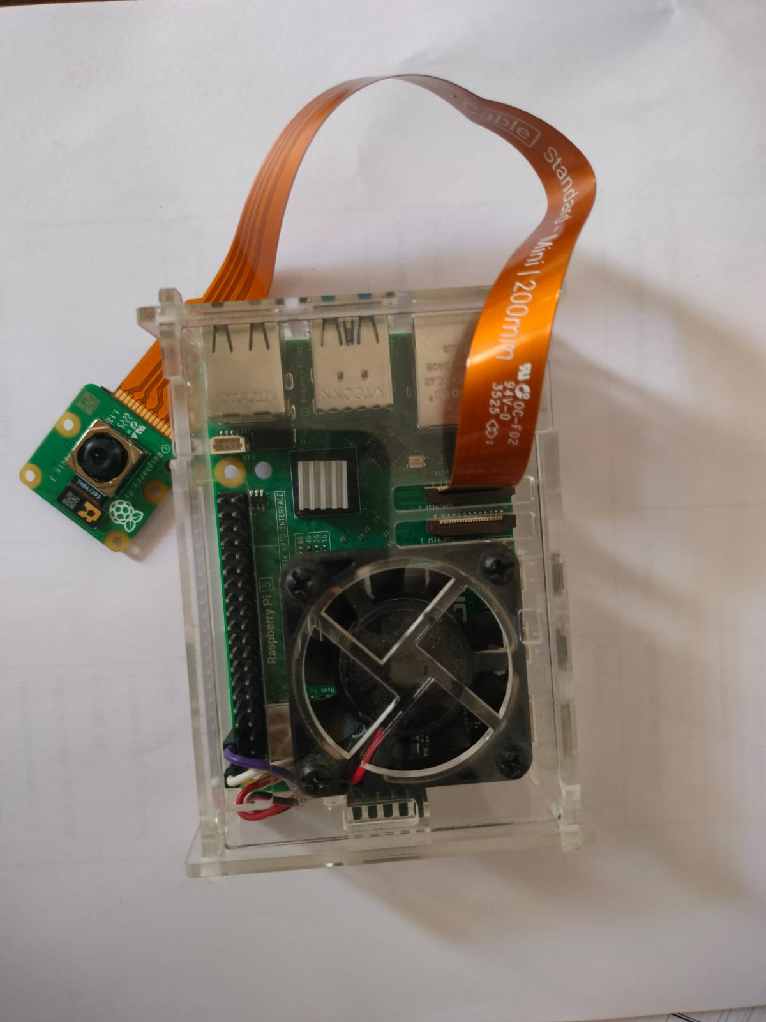
Phase -1 Results
Hardware

Slide 26
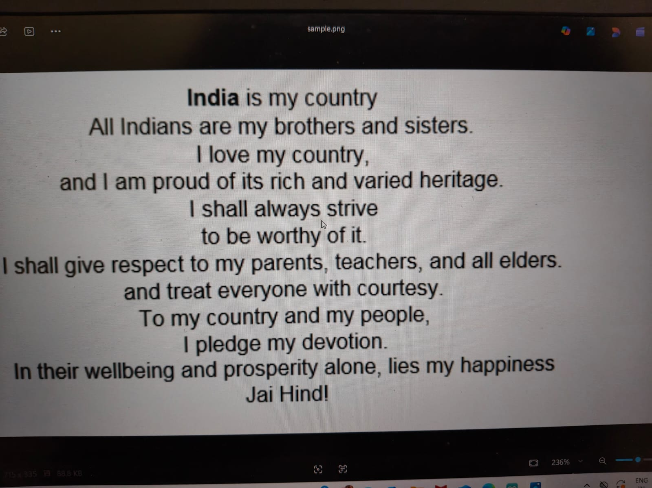
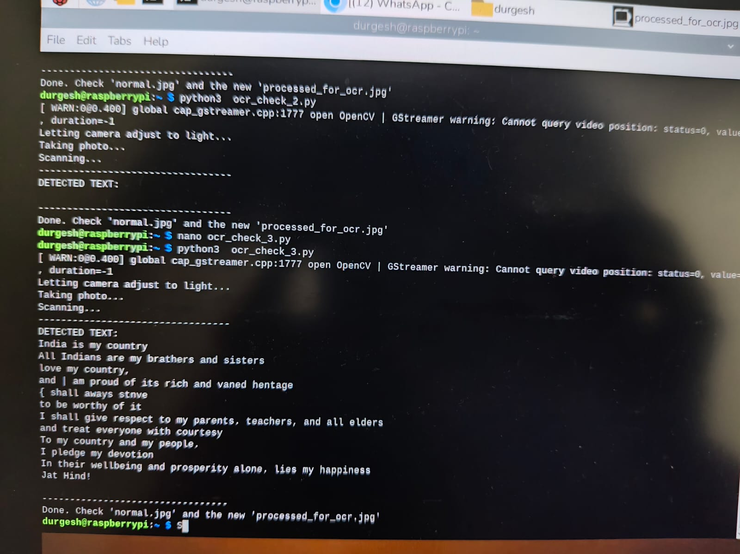
Phase -1 Results
Phase -1 Results

Slide 27
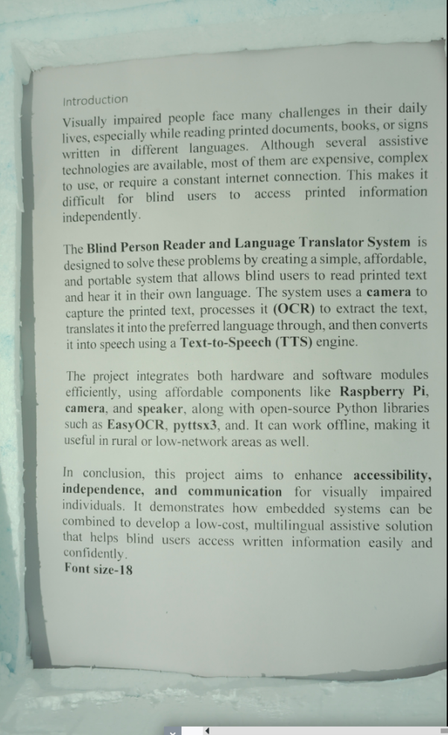
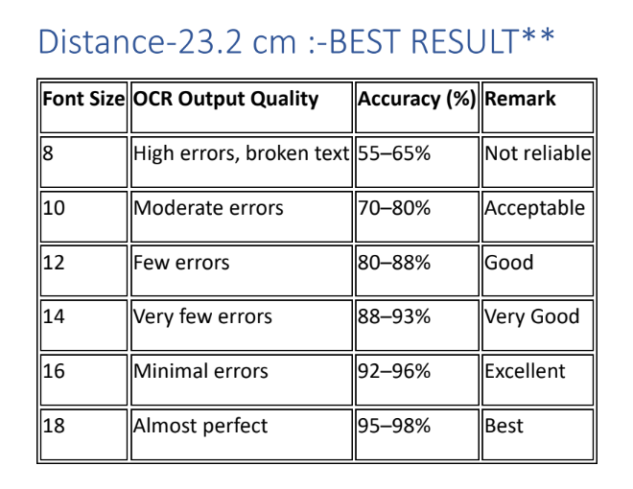
Phase -1 Results
Phase -2 Results

Slide 28
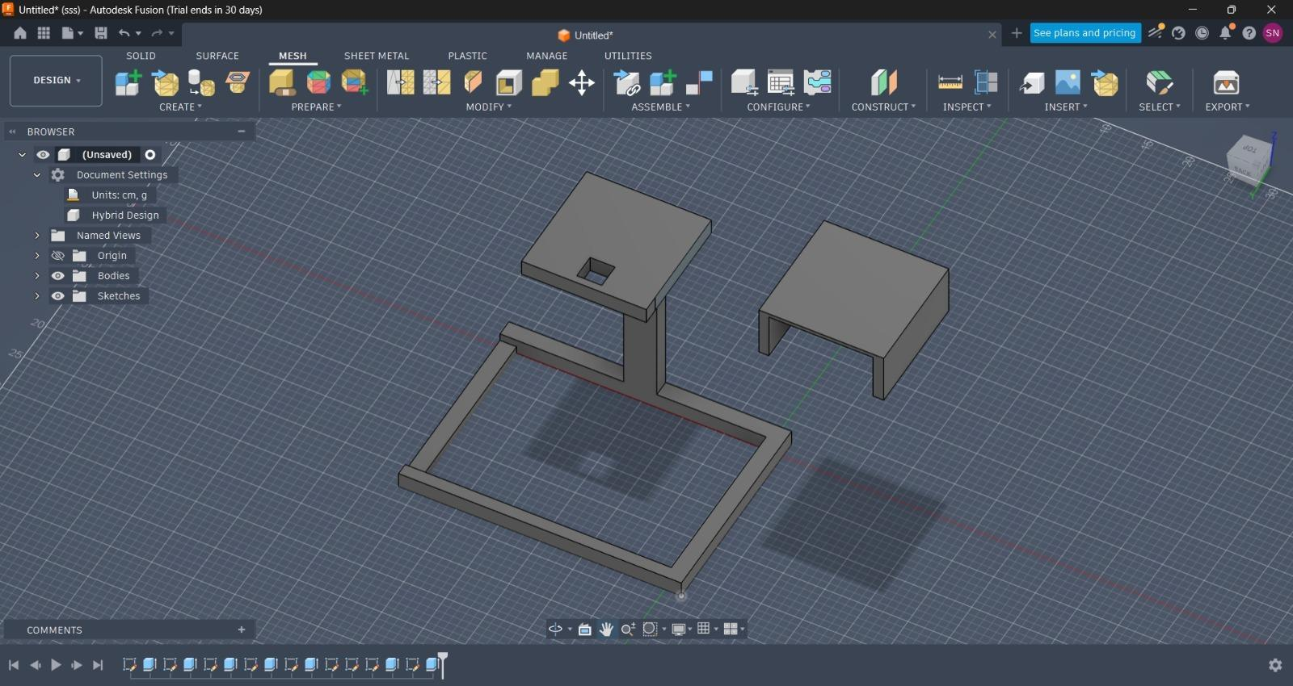
Phase -1 Results
3D Model Prototype

Slide 29
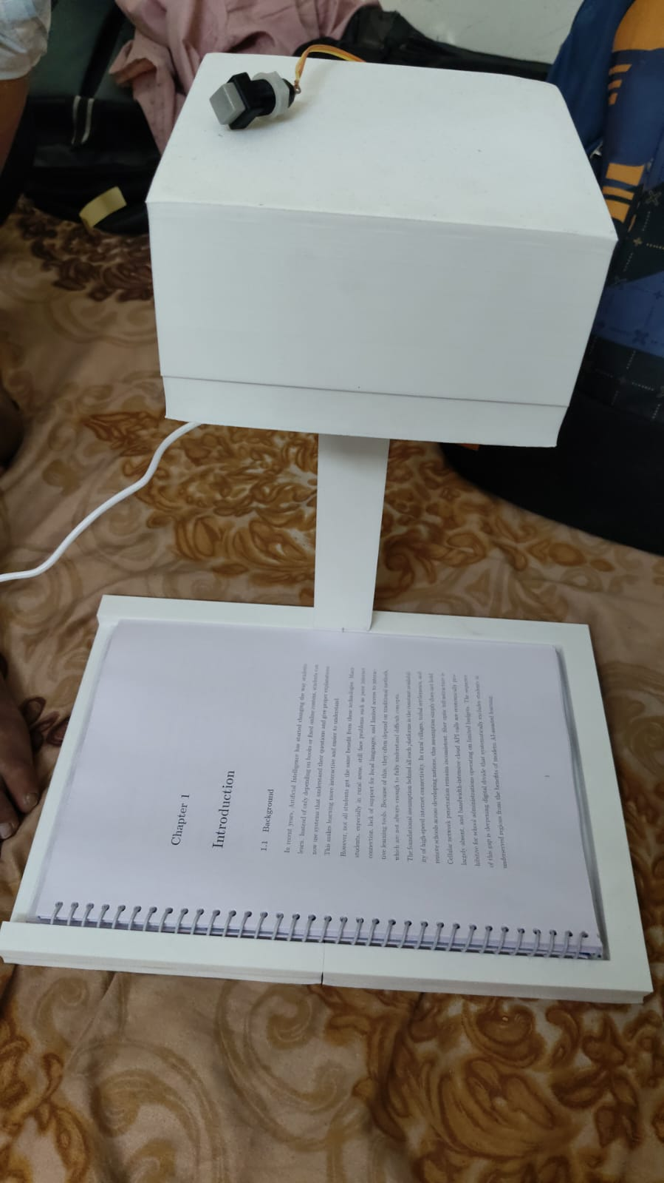
Phase -1 Results
3D Model

Slide 30
Conclusion
Conclusion
The project is a low-cost, portable assistive system for visually impaired users. It captures printed text, translates it into the preferred language, and provides offline speech output. This enhances independence, accessibility, and ease of learning in daily life.

Slide 31
References
2014 Published by Elsevier Ltd. This is an open access article under the CC BY-NC-ND license (http://creativecommons.org/licenses/by-nc-nd/3.0/)
Daxiang Dong, Hua Wu, Wei He, Dianhai Yu and Haifeng Wang Baidu Inc, Beijing, China {dongdaxiang, wu hua, hewei06, yudianhai, wanghaifeng}@baidu.com
https://doi.org/10.3991/ijim.v15i19.24139 Norharyati Harum(), Nur’aliah Izzati M. S. K, Nurul A. Emran, Noraswaliza Abdullah, Nurul Azma Zakaria, Erman Hamid, Syarulnaziah Anawar University Teknikal Malaysia Melaka, Durian Tunggal, Malaysia
2020 The Authors. Published by ELSEVIER B.V. This is an open access article under the CC BY-NC-ND license https://creativecommons.org/licenses/by-nc-nd/4.
Image Text To Speech Conversion In The Desired Language By Translating With Raspberry Pi
https://ieeexplore.ieee.org/abstract/document/7919526
A Text Reader for the Visually Impaired using Raspberry Pi
https://ieeexplore.ieee.org/abstract/document/8487513

Slide 32
References
Vision Voice: A Raspberry Pi-based Text-to-Audio Converter for the Visually Impaired
https://ieeexplore.ieee.org/abstract/document/10664121
Regional Language Reading Aid for Blind People Using Raspberry Pi
https://ieeexplore.ieee.org/abstract/document/10991202
Raspberry pi based Intelligent Reader for Visually Impaired Persons
https://ieeexplore.ieee.org/abstract/document/9074948
Reading Aid and Translator with Raspbery Pi for Blind People
https://ieeexplore.ieee.org/abstract/document/10113042

Slide 33
Thank You!!

